Slide 1
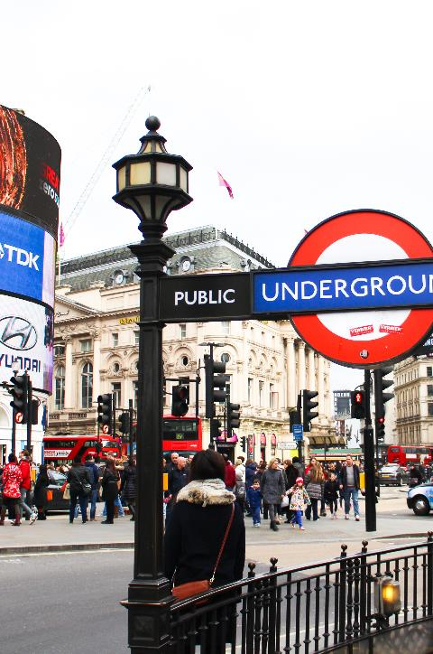
Settlements

Slide 2
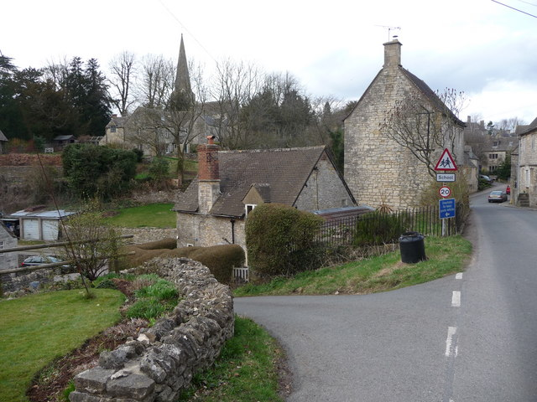
Today’s lesson
2. What is a village?
Notes:
Notes for teachers’ use only: In Lesson 1, we introduced the term ‘settlement’ and the basic settlement hierarchy (hamlet, village, town, city). We then focused on the population size and facilities likely to be found in a hamlet. In this lesson, we introduce the next step in the hierarchy, the village. If your school is in a village, do make reference to your own context when appropriate.

Slide 3
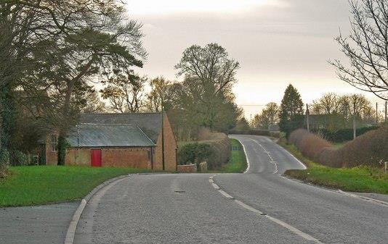

Let’s say these as full sentences very quickly!
Wherever people live, we call this a s_______.
In the UK, a h______ is the smallest type of settlement.
The things you usually find in a hamlet are p______ and h______.
settlement
hamlet
people
houses
hamlet | people | settlement | houses
Let’s check we understand.

Slide 4
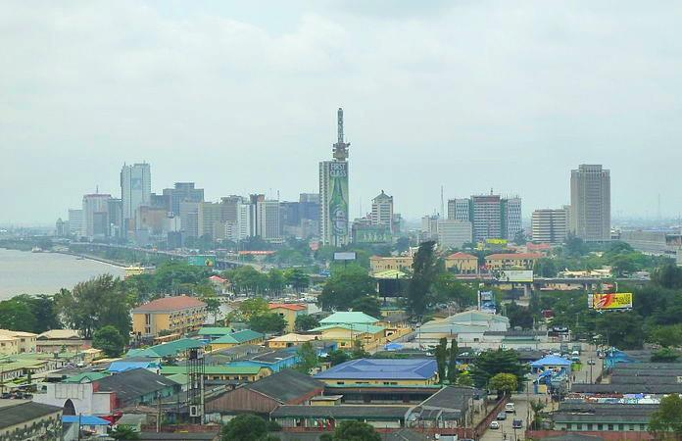
Is this a settlement? How do you know?
.
This is not a hamlet! How do you know?
Let’s check we understand.
Notes:
We know it’s a settlement because it’s a place where people live. It’s too big to be a hamlet – we can see many houses.

Slide 5
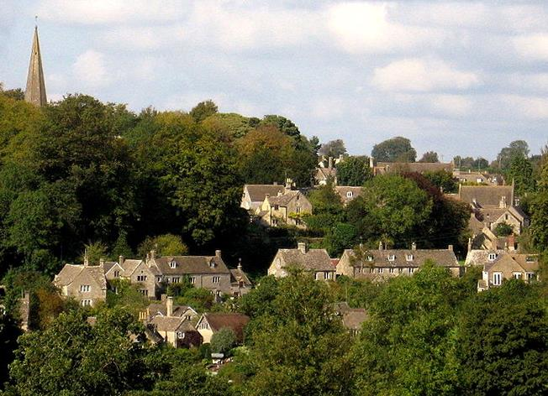

This is a settlement in England.
This settlement has a church.
This settlement has even more houses.
This settlement is not a hamlet.
.
Let’s look carefully.

Slide 6

This is settlement is a village.
A village is the most common type of human settlement.
.
Let’s use a new word.
Notes:
In this unit, we’re focussing on one example of a ‘typical’ village so that children have a picture that sticks in their memory. In practice, villages vary in size, shape and character, especially when we consider villages around the world. We start with a simple introduction to each type of settlement, then children will see diverse examples and build up their understanding of the range of settlements as they progress through the curriculum.

Slide 7
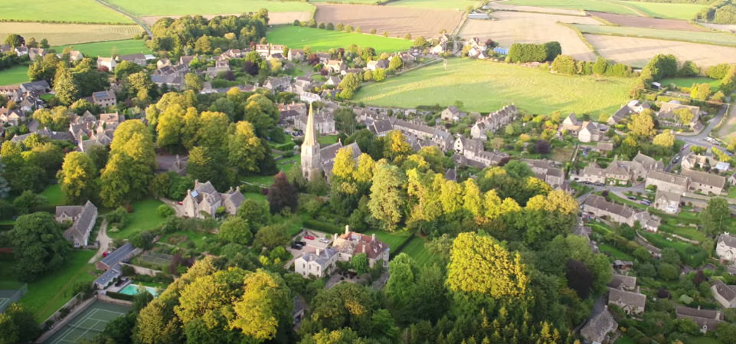
This is a photograph taken from the air of the village of Bisley.
Bisley is a village in an area surrounded by green fields.
Bisley is surrounded by land used for farming.
Villages are in the countryside. Rural means countryside.
.
Let’s use a new word.
Notes:
Rural and urban is a key pairing of terms in geography. We will come back to these terms many times through the curriculum.

Slide 8
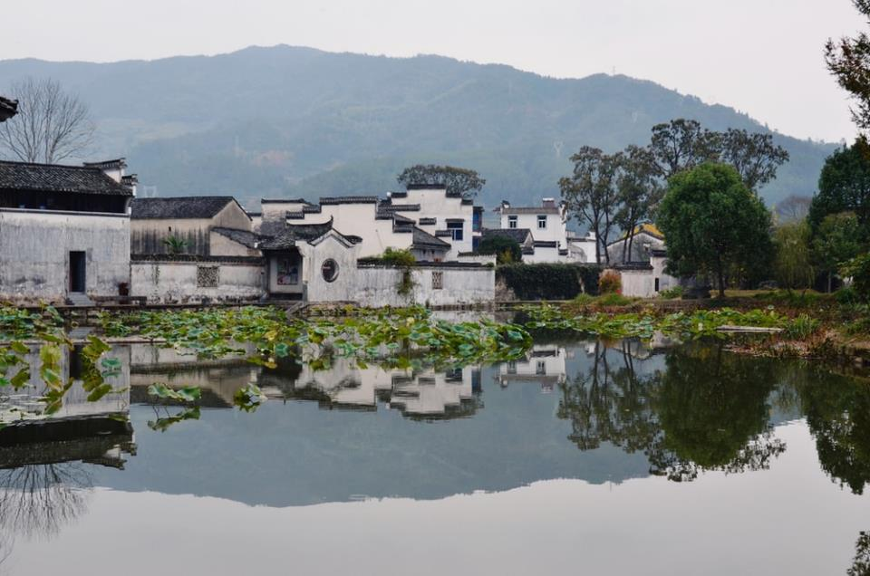
This is a rural settlement.
.
Let’s check we understand.
Notes:
Look at the photograph with the class. Notice the countryside around the settlement – in this case some hills and forests.

Slide 9
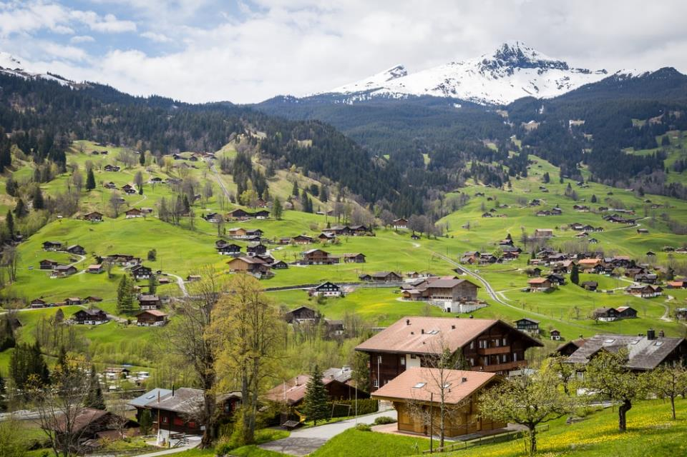
This is a rural settlement.
.
Let’s check we understand.
Notes:
Look at the photograph with the class. Notice the countryside around the settlement – in this case some fields, hills and mountains.

Slide 10
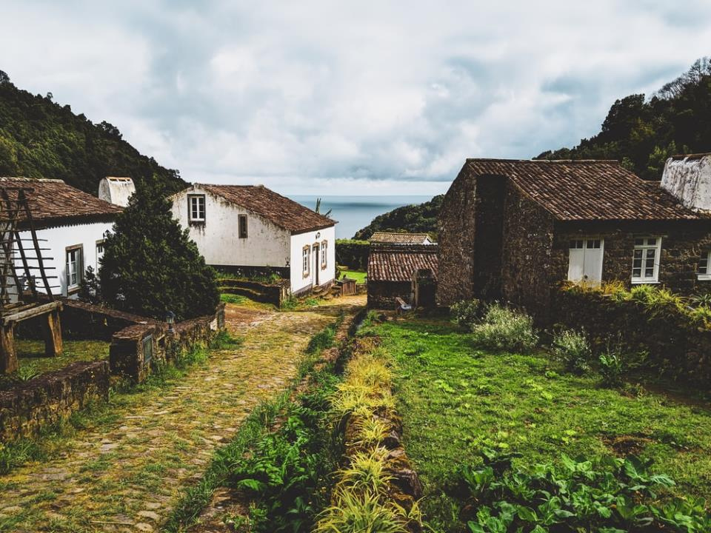
This is a rural settlement.
.
Let’s check we understand.
Notes:
Look at the photograph with the class. Notice the countryside around the settlement – in this case some hills and woods. This settlement is near the coast.

Slide 11
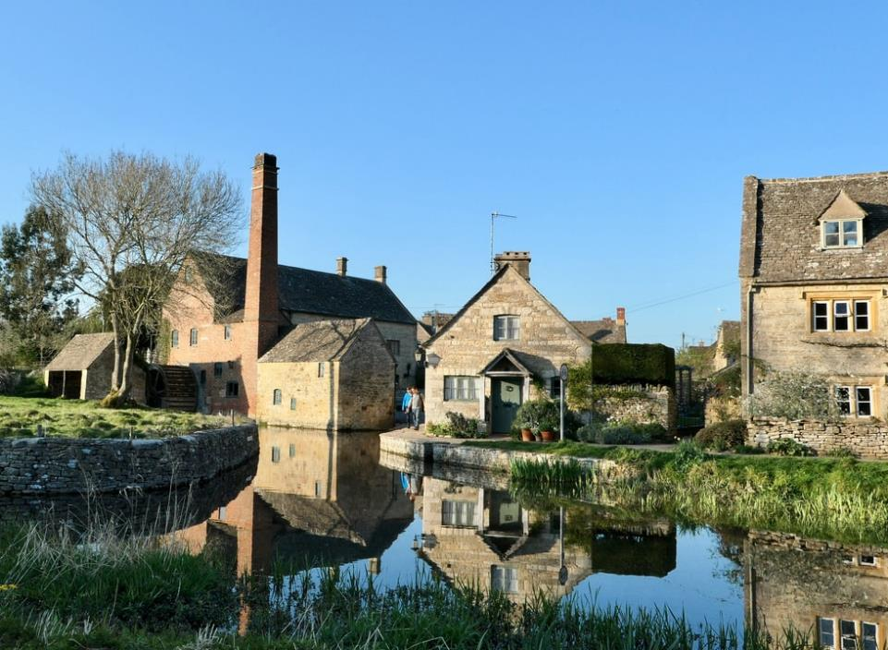
This is a rural settlement.
.
Let’s check we understand.
Notes:
Look at the photograph with the class. We can’t see a lot of countryside in the photograph, but the area has an open feel with water and trees. There are no tall buildings.

Slide 12
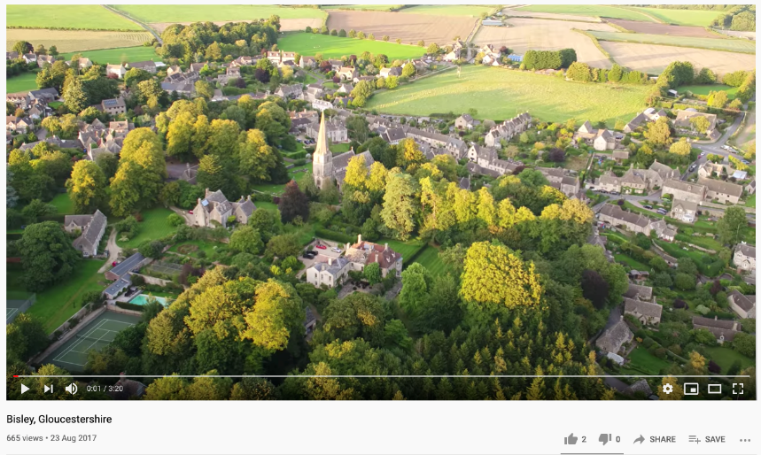

Imagine that two people live in every house in this village.
So, try to count in twos in your head (not out loud), as we watch this clip of the village of Bisley.
How many people might live in the village of Bisley?
.
https://www.youtube.com/watch?v=d3DKn-koq7g&t=2s
Let’s watch this clip and look carefully.

Slide 13
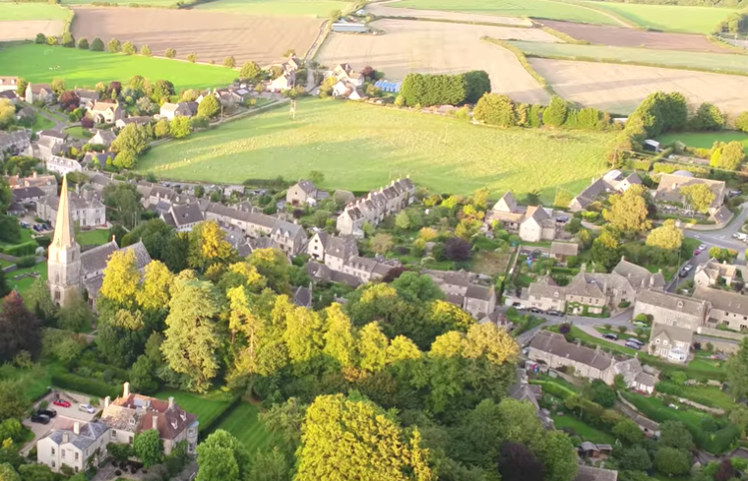
Around 2,100 people live in the village of Bisley!
We call people who live in a settlement the inhabitants.
How many inhabitants are there in the village of Bisley?
.
Let’s learn and use a new word.

Slide 14
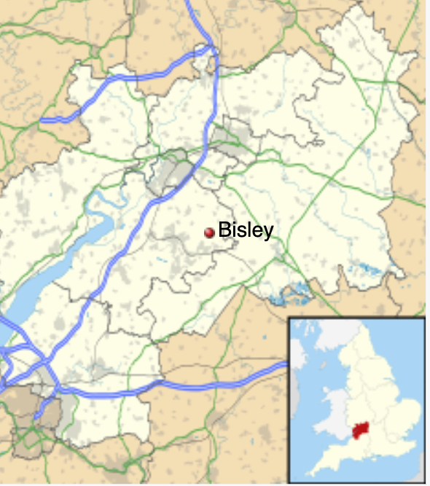
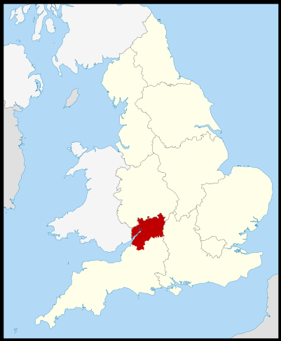

.
Where is the village of Bisley?
Where are you? Do you live in a village?
Let’s learn and use a new word.
Notes:
This is a good opportunity to practise describing a location, using 4-point compass, simple directional language and recalling previous knowledge about the UK. For example “Bisley is in the west of England” or Bisley is to the east of Wales”, “Bisley is near the coast”. You can also apply the use of rural – “Bisley is a rural settlement” or “Bisley is in a rural area”.

Slide 15
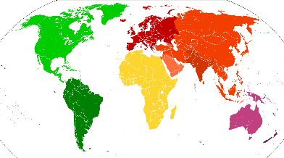
A village is the most common type of human settlement.
Villages are in the countryside. They are rural settlements.
Every country in the world has people who live in villages.
.
Let’s use our new word.

Slide 16
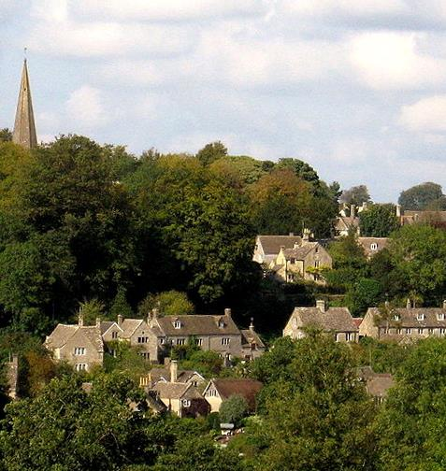

Let’s read Page 8 in our Settlements booklet.
Let’s use our new word.

Slide 17
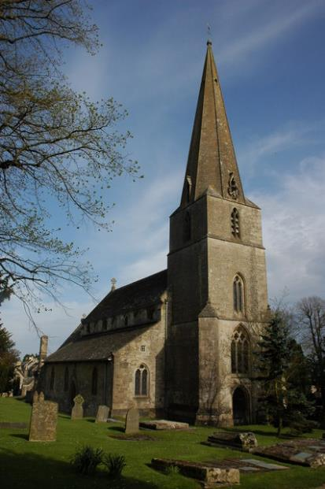
In the UK, almost every village has a church.
Find the church in the village of Bisley.
.
Let’s use our new word.

Slide 18
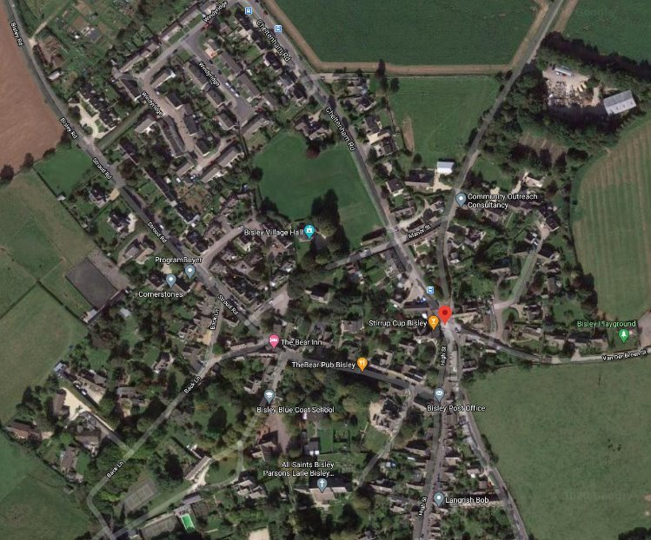
Bisley is a village in England.
Your teacher will give you a copy of this photo to stick into your book.
.
Find the village church.
The church in Bisley is called ‘All Saints.’
Let’s look carefully.
Notes:
This is a vertical aerial photo (a bird’s eye view). Check children can correctly interpret what it shows from above – trees, roads, fields, buildings etc – before going on to look at the additional information in the overlay (road names and facilities).
What can you see on the photograph? A school? A post office? (check children are aware what a post office is) A playground? A village hall? (check children are aware what this is)

Slide 19



What is a village?
On the next page, write the word village in a box.
Let’s add the things you find in a village in the UK.
We need more than just houses and people. Why?
church
houses
people
village
Let’s draw and write.
Notes:
Some villages have more facilities than others. Refer to examples from your own village if your school is in a village.

Slide 20

Bisley is a village in England.
.
This is the village green.
Let’s look carefully.
Notes:
A village green is an area of open space with grass (a bit like a park). Sometimes people play sports on the village green or use it to walk their dog.

Slide 21
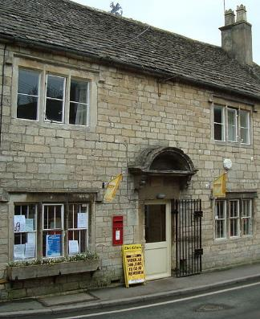
What is a village?
church
houses
people
post office
village
village green
small shops
Let’s draw and write.

Slide 22
Bisley is a village in England.
.
Let’s find the post office.
Let’s look carefully.
Notes:
Check children understand what a post office is (refer to a local one if there is one in your settlement).

Slide 23
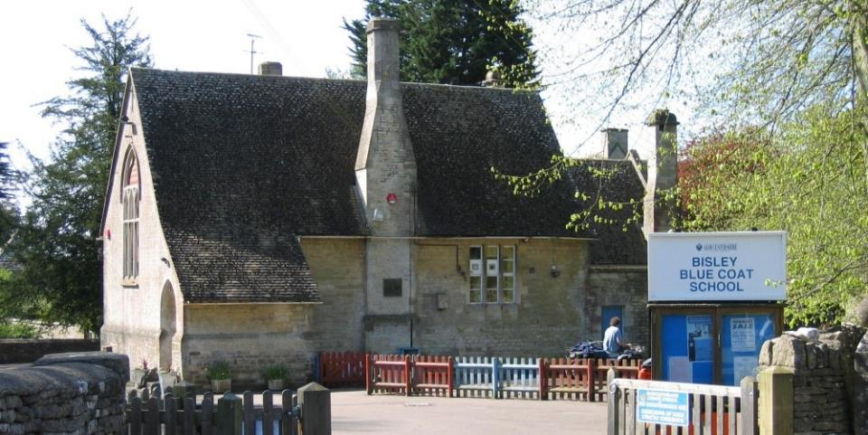
What is a village?
church
houses
people
post office
village
village green
primary school
small shops
Let’s draw and write.
Notes:
Not all villages will have these facilities, but most will have some of them.

Slide 24
Bisley is a village in England.
.
Let’s find the school.
Let’s look carefully.

Slide 25
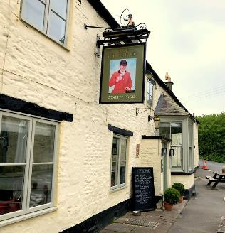
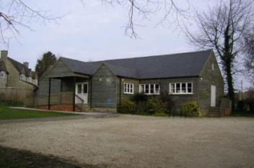
What is a village?
church
houses
people
post office
village
pub
village hall
village green
primary school
small shops
Let’s draw and write.

Slide 26
Bisley is a village in England.
.
Let’s find the village hall.
Let’s find the pub.
Let’s look carefully.
Notes:
‘Pub’ is short for a public house. This was somewhere that people could buy drinks and socialise. Now most pubs are also restaurants and some have accommodation.

Slide 27

What is a village?
Now write some sentences.
What is different between a village and a hamlet?
What is similar about a village and a hamlet?
village
Let’s discuss and write.

Slide 28
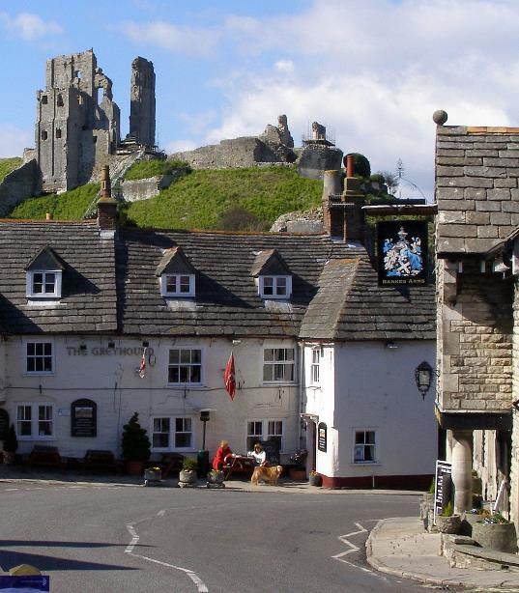
.
This is a pub.
Is this settlement a hamlet or a village?
If this settlement only had some houses, is it a hamlet or a village?
If this settlement had a church and a primary school, ...
Let’s use our new words and remember.
Notes:
Again, we are establishing the usual situation here. There will always be exceptions.

Slide 29
city
town
village
hamlet
Types of settlement
Last lesson, you drew this triangle diagram on a full page and divided it into four.
What things do you find in a village?
How many can you remember without looking at your notes?
Let’s discuss, draw and write.

Slide 30

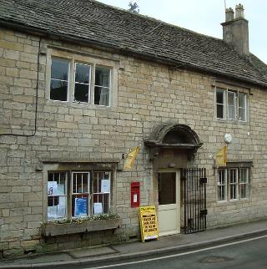
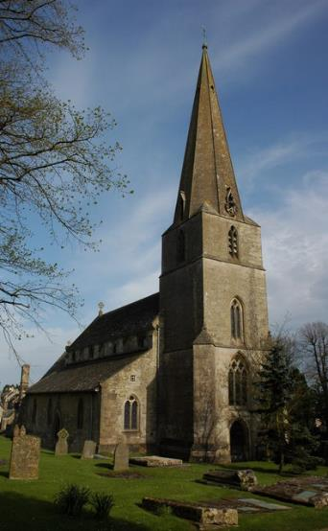
Let’s read Pages 9, 10 and 11 in our Settlements booklet.
Let’s read together.

Slide 31
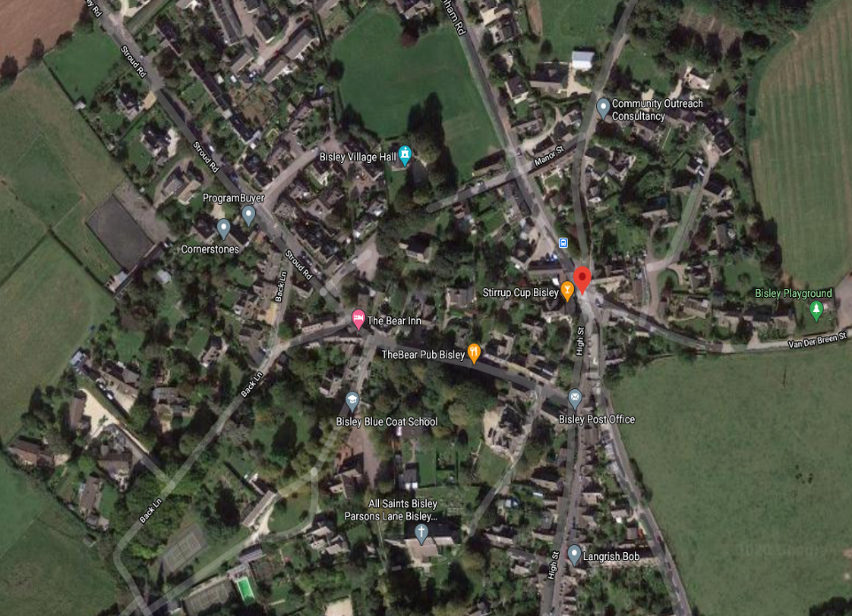
In a village in the UK we normally find......
Let’s try to remember very quickly!
How many can you remember?
Let’s check we understand.

Slide 32
In a village in the UK we normally find......
Let’s try to remember very quickly!
How many can you remember?
c _ _ _ _ _
p _ _ _ _ _
h _ _ _ _ _
p _ _
p_ _ _
o _ _ _ _ _
p _ _ _ _ _ _
s _ _ _ _ _
v_ _ _ _ _ _ g _ _ _ _
v _ _ _ _ _ _
h _ _ _
s _ _ _ _
s _ _ _ _
Let’s check we understand.

Slide 33
In a village in the UK we normally find......
Let’s try to remember very quickly!
How many can you remember?
church
people
houses
pub
post office
primary school
village green
village hall
small shops
Let’s check we understand.

Slide 34

Bisley is a village in England.
Bisley is a village in England.

Slide 35

Bisley is a village in England.

